Slide 1
Improving the energy efficiency of the existing building stock: A critical review of commercial and institutional buildings
Rajeev Ruparathna, Kasun Hewage, Rehan Sadiq
Renewable and Sustainable Energy Reviews

Slide 2
Conceptual background
Buildings are accountable for tremendous usage of energy that translates to environmental concerns worldwide [3]
40% energy
25% water
40% resources
1/3 of the total GHG (greenhouse gas emission)

Slide 3
Conceptual background
Commercial and institutional buildings’ impact on environment, society, and economy
In Canada, total operational energy expenditures of commercial and institutional buildings exceed 24 billion CAD; 3% of Canada’s GDP [5]
In Canada, the total energy use of the same buildings is 1057 petajoules (PJ) which is 12% of the secondary energy use and 11% of the total GHG emission
The heat discharged from the buildings in urban settings creates the heat island effect, which is a noteworthy issue for urban centers in warm climates [7]
Forecasts show that in the future, energy consumption portion of commercial buildings is expected to increase while the energy consumption portion of residential buildings is expected to decrease [4].

Slide 4
Conceptual background
Improving energy efficiency to minimize environmental effects from buildings
Poor energy performance of existing buildings is a commonly observed issue around the world [28]
The basic principle of the building energy efficiency is to use less energy for operations (i.e. for heating, cooling, lighting and other appliances), without impacting the health and comfort of its occupants; functionality of the building
This approach would eventually reduce primary energy use and CO2 [9,10, 11] that translates to less GHG emission and less cost

Slide 5
Conceptual background
Improved energy efficiency can be achieved through:
Technological change
Organizational/Management change
Behavioural change
In practise, a systematic technical and management change is required to achieve greater environmental and energy targets for the future [25]
However so far, building energy efficiency improvements projects have been conducted in ad hoc basis [27]
Therefore, a consolidated knowledge base is required to inform the decision makers about the best course of action to suit their situation, prior to opting for detailed analysis for retrofit alternatives
research on green buildings has expanded into various areas and contexts, still there is a lack of systematic review of the widespread knowledge [30]
there are no comprehensive studies specifically focused on improving energy performance of operating buildings.

Slide 6
This study looks at various approaches in the literature to improve the energy performance of commercial and institutional buildings.
From identified peer reviewed journals:
Energy policy
Energy and buildings
Energy Conversion and Management
Solar energy
Renewable energy
Energy
Applied energy
Renewable and Sustainable Energy Reviews

Slide 7
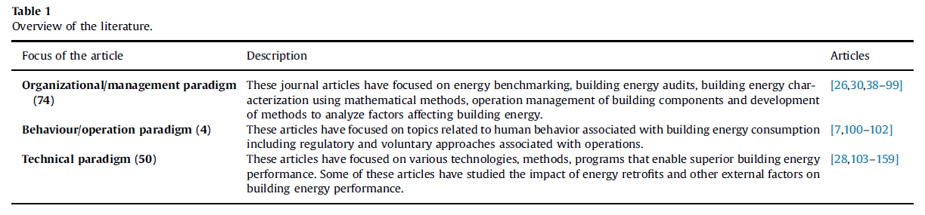
Based on the study objectives, retrieved articles were categorized into three paradigms of building energy efficiency

Slide 8
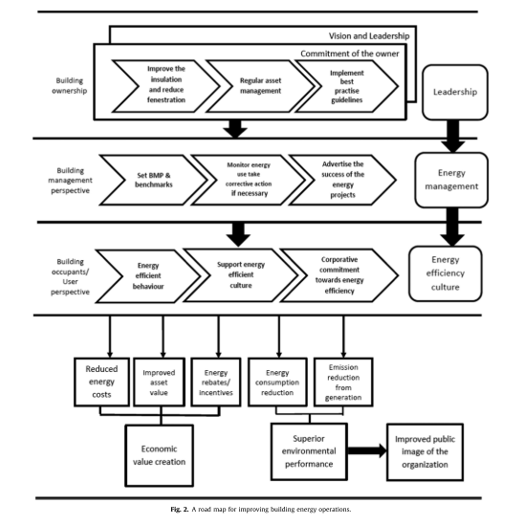
Roadmap

Slide 9
Results and Discussion
Currently, building professionals and researchers are keen on designing and developing net zero buildings and net positive buildings
There has been an upward trend in innovations related to building energy performance (could be due to higher energy price, adoption of building codes, etc.)
To improve energy efficiency of buildings, there should be energy efficiency promotion, reducing energy consumption, alternative energy production, and improving the social awareness through private initiatives and supported by government intervention

Slide 10
Results and Discussion
Seek beyond the common methods and identify state-of-the-art technologies

Slide 11
Future works
It is evident from the literature that that there is a considerable need for studies that are focused on behavioural specific improvements.
Further research is required to understand how organizations develop energy management best practises and implement them.
As per the authors knowledge there are no comprehensive studies focused on building asset management.
Safety risks, design, installation, and regulatory barriers associated with innovative technologies should be studied before there are used in practise

Slide 12
Future works
Metering and control systems, measures to ensure low cost thermally comfortable and productive environments, state-of- the-art equipment and technologies that provide heating, cooling and electricity with lower carbon footprint
Enhanced use of information technology, improved sensors, real-time monitoring and automated decision-making systems would support building energy management in an innovative way.

